Slide 1
Tracking Space Weather Application Progress Towards Usability: Application Usability Levels.
Alexa Halford, Adam Kellerman, Barbara Thompson, Antti Pulkkinen, Katherine Garcia-Sage, Brett Carter, Sophie Murray, Suzy Bingham, Dan Welling, and the Assessment of Understanding and Quantifying Progress Working Group
November 2018

Slide 2
Connections
How best to find research ready for operations and operational needs where research can help.
Barrier for effective applied space weather: (from the research side)
Finding and knowing best how to communicate with end users
Knowing what research will produce useful tools to aid decision making processes.
Knowing the requirements and needs of the user community
Advertising how our research could be useful
NASA
Connections
Notes:
https://www.nasa.gov/directorates/heo/scan/images/history/Early1964.html

Slide 3
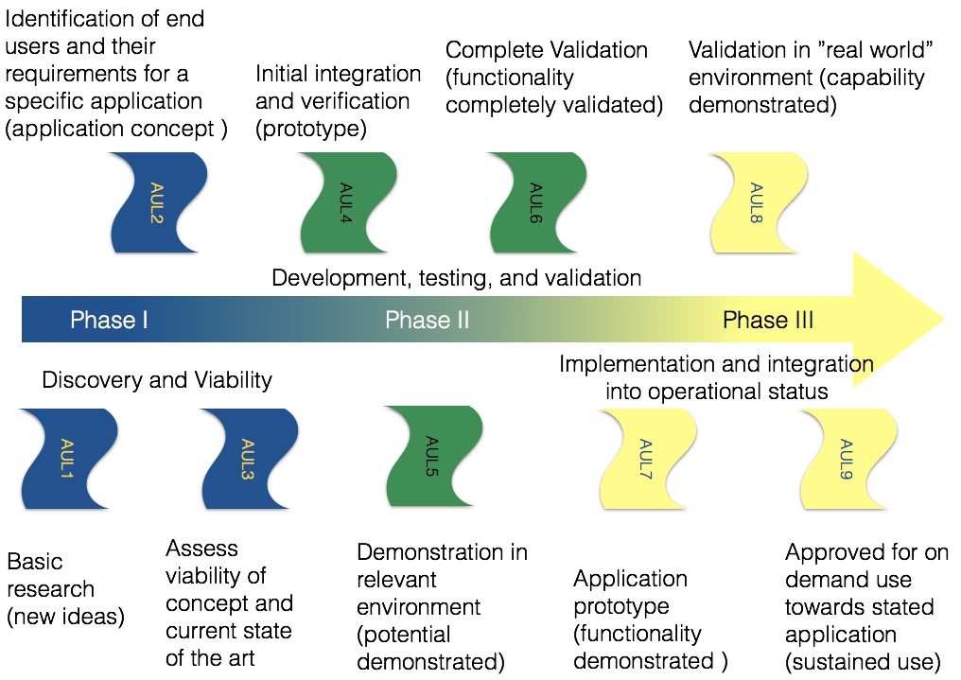
Application Usability Levels
Proposed tracking method
AUL: Application Usability Level
An effective framework to aid in communication, track progress of a project towards completion, and advertise user needs and research capabilities.
AULs

Slide 4

Application Usability Levels
The three phases
AUL: Application Usability Level
Phases:
Phase 1: Discovery and Viability
Phase 2: Development, Testing, and Validation
Phase 3: Implementation and integration into operational status.
Development, testing, and validation
Phase I
Phase II
Phase III
Discovery and Viability
Implementation and integration into operational status
AULs

Slide 5
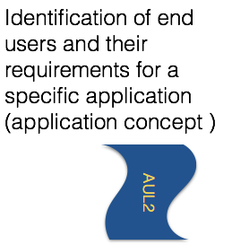

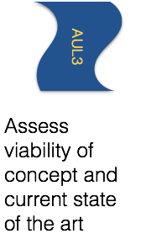
Application Usability Levels
The three phases
AUL: Application Usability Level
Phase 1
Phase I
Discovery and Viability
AULs
Notes:
Phase 1: Where fundamental Research becomes applied. Not all research may or should progress beyond the very first AUL. However, if there is a potential user identified, whether they are a fellow researcher or an industry partner, then this phase will determine whether the project should progress to phase II.

Slide 6
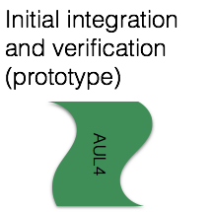
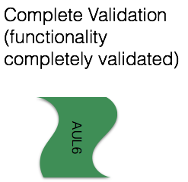
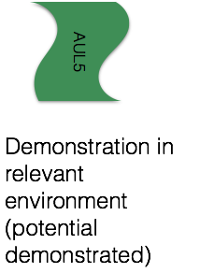
Application Usability Levels
The three phases
AUL: Application Usability Level
Phase 2:
Development, testing, and validation
Phase II
AULs
Notes:
Phase 2: Focus on finalizing development of the new state-of-the-art project integrating the resulting tools into the identified applications, demonstrating the feasibility of the new product and validating the new system.

Slide 7
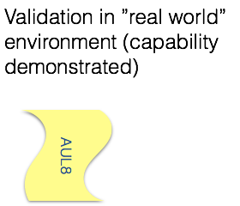
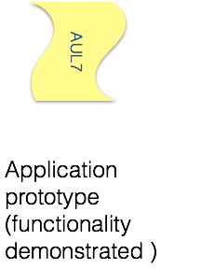
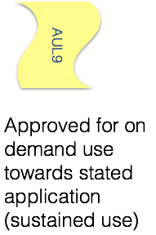
Application Usability Levels
The three phases
AUL: Application Usability Level
Phase 3:
Phase III
Implementation and integration into operational status
AULs
Notes:
Phase 3: Where the project is handed off and fully integrated into the end user's application. This also includes new validation efforts to determine how well the new application performs in a ``real world" setting. Validation and continued use in an operational environment drives discovery of new science questions, problems, and of course new applications.

Slide 8
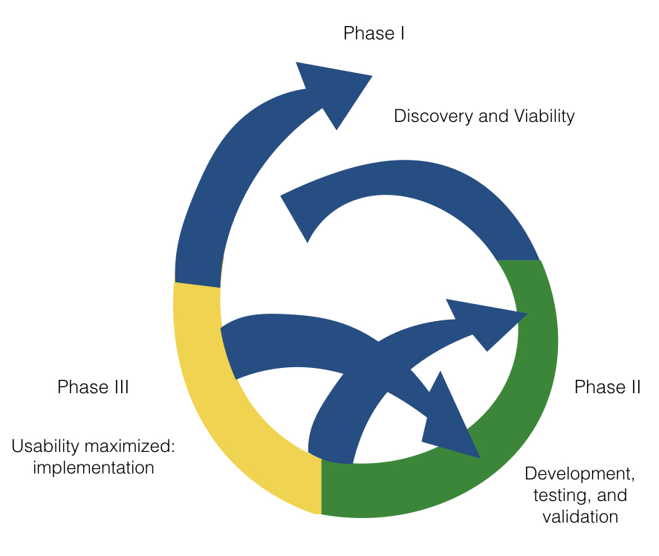
Application Usability Levels
The three phases
AUL: Application Usability Level
During the process:
AULs

Slide 9
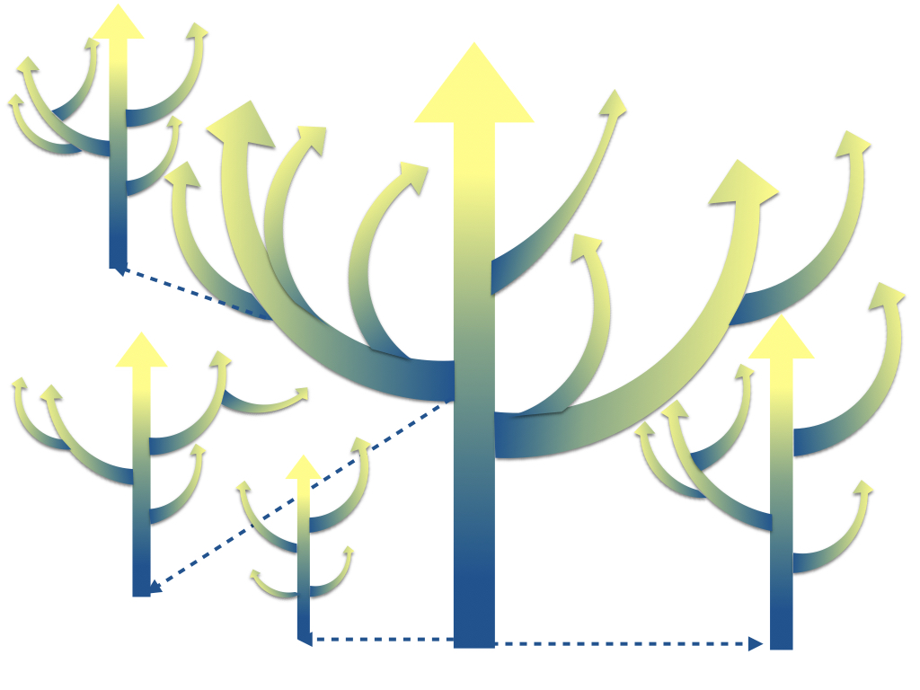

Application Usability Levels
The three phases
AUL: Application Usability Level
Beyond AUL 9
AULs
Notes:
Beyond AUL 9: During this process, it is likely that you have found other projects or applications. In this framework it all feels like there is a clear start and stop, but this is far from the truth.
New end users, new applications, and altogether new projects are identified. Just like any good research project, there is always more to do and more to learn and improvements to be made.

Slide 10
Application Usability Levels
Examples
AUL1: Project
Jeff has a new cubesat mission and believes that their data will be useful to modelers. They have just written their instrument paper and have started considering the temporal and types of data products which will be useful as an input for modelers.
Milestones:
AUL1 - Ideas for how project output may enhance decision making or be applied to an end user application.
AUL1 - Research is documented and disseminated for the project, so that the usability may be assessed by way of the AUL method.
AUL1 - Potential interested end users are identified, but not necessarily contacted.
Phase I
Discovery and Viability
AULs

Slide 11

Application Usability Levels
Examples
AUL1: Project
Jeff has a new cubesat mission and believes that their data will be useful to modelers. They have just written their instrument paper and have started considering the temporal and types of data products which will be useful as an input for modelers.
Milestones:
AUL2 - Formalization of the application.
AUL2 - An end user is contacted and avenues of communication are established.
AUL2 - Identification and formalization of the requirements and metrics necessary for successful application of the project for the end user's needs.
Phase I
Discovery and Viability
AULs

Slide 12
Application Usability Levels
Examples
AUL6: Project
Brett has a new real-time forecasting model of plasma bubbles for the Australian Bureau of Meteorology. Together they have determined specific metrics and requirements. The new model has been validated and working for the relevant environments in a simulated operational environment at RMIT and shown to be better than the current state of the art. The results were just published in Space Weather.
Milestones:
AUL6 - Prototype application system beta-tested in a simulated operational environment.
AUL6 - Projected improvements in performance of the state-of-the-art and/or decision making activity demonstrated in simulated operational environment.
Development, testing, and validation
Phase II
AUL6 - Publication of the specific application and associated metrics and the projects progress towards this application.
AULs

Slide 13
Application Usability Levels
Examples
AUL6: Project
Currently they are transferring the model to the Australian Bureau of Meteorology along with the code to test and validate it on the new system. Along with the publication of the new metrics and requirements for the specific application, they also demonstrate the functionality of the new system, and show it off at the ASRC workshop to potential new users.
Milestones:
AUL7 - The system must be fully integrated into the operational environment specified by the end user.
AUL7 - The system's functionality is tested and demonstrated in the end user's specified relevant environment.
AUL7 - Project team must demonstrate the functionality of the new system for the end user's application and disseminate the results.
Development, testing, and validation
Phase II
AULs

Slide 14
Tracking AULs
Website framework development in progress: Landing page?
Applications:
GIC impacts: User requirements and metrics
Link to CCMC metric/validation activities
1
2
3
4
5
6
7
8
9
Project 1
Project 2
Project 3
Sudden event upsets : User requirements and metrics
Link to CCMC metric/validation activities
1
2
3
4
5
6
7
8
9
Project 1
Project 3
Project 2
CME Arrival: User requirements and metrics
Link to CCMC scoreboard and metric/validation activities
1
2
3
4
5
6
7
8
9
Project 4
Project 1
Project 6
Project 2
Project 5
Project 3
Tracking AULs

Slide 15
Tracking AULs
Website framework development in progress: Project specific page?
Applications: GIC impacts - User requirements and metrics
Project 1. – Brief description
1
2
3
4
5
6
7
8
9
Project 1
Team: Lead by X
Website: (if available)
Contact info: (if available)
Publications/talks:
Links ect.
If available -> example of the output
Tracking AULs

Slide 16
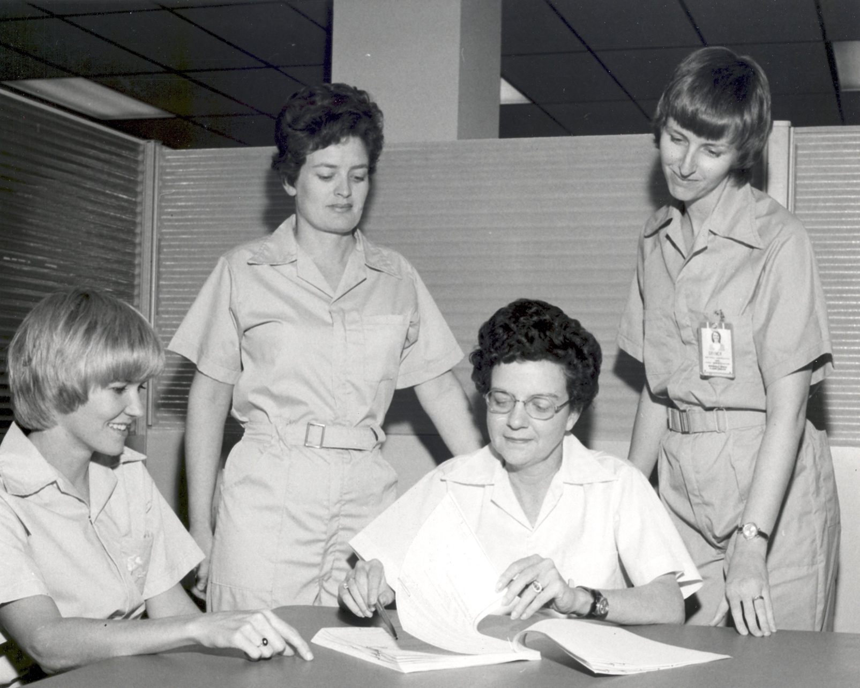
Get involved
Assessment of Understanding and Quantifying Progress
International Forum for Space Weather Capabilities Assessment
https://ccmc.gsfc.nasa.gov/assessment/forum-topics.php
Assessment of Understanding and Quantifying Progress:
https://ccmc.gsfc.nasa.gov/assessment/topics/trackprogress.php
http://spacewx.weebly.com/tracking-progress.html
AUQP
MSFC/NASA
Notes:
Image from NASA
https://www.flickr.com/photos/nasacommons/7538841680/
Materials Science Experiments Conducted at MSFC
In another first for NASA, an all-female crew of scientific experimenters began a five-day exercise on December 16, 1974, to test the feasibility of experiments that were later tested on the Space Shuttle/Spacelab missions. The experimenters, Dr. Mary H. Johnston (seated, left), Ann F. Whitaker and Carolyn S. Griner (standing, left to right), and the crew chief, Doris Chandler, spent spend eight hours each day of the mission in the Marshall Space Flight Centers General Purpose Laboratory (GPL). They conducted 11 selected experiments in materials science to determine their practical application for Spacelab missions and to identify integration and operational problems that might occur on actual missions.
Image # :565782
Date: November 13, 1974

